Slide 1

ECMWF progress
Sean Healy

Slide 2
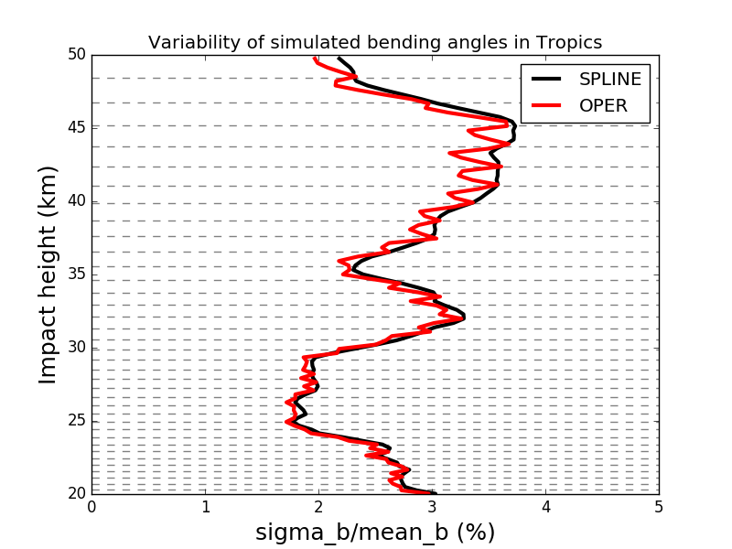
Cubic spline interpolation for refractivity tested in a 2D operator: Unphysical bending angle variability between model levels first noted by DMI.(TL and AD)
Typical model
level heights in tropics

Slide 3
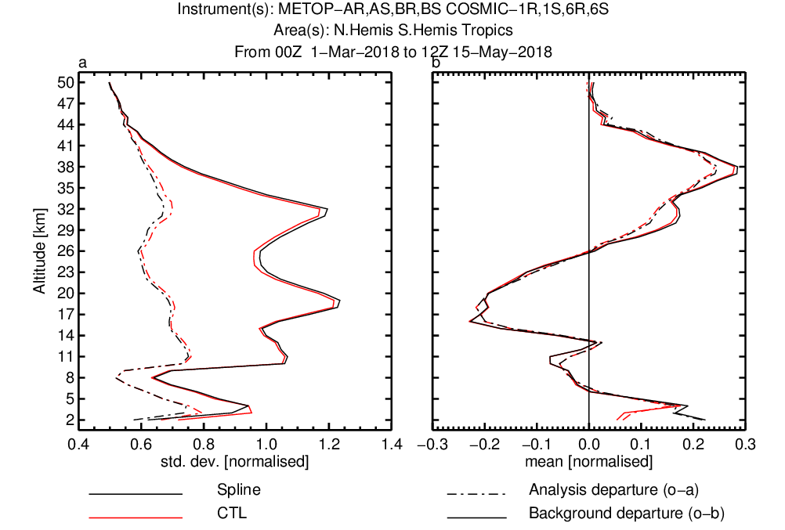
Cubic spline interpolation for refractivity in the 2D operator

Slide 4

Continued ROM SAF collaboration with CMA for GNOS RO measurements
Recap
ROM SAF ROPP code is used to processes the operational GNOS bending angles.
ROM SAF VS activity supported Mi Liao to visit ECMWF in 2017 to improve the GNOS processing.
FY-3C assimilated operationally at ECMWF since March 2018.
  Also now in DWD/Met Office.
Mi Liao has provided 4 days (May 2-5, 2018) of FY-3D data and they have been tested in the NWP system. Larger FY-3D noise above 30 km.
2nd FY-3D dataset, July 2-5, 2018.

Slide 5
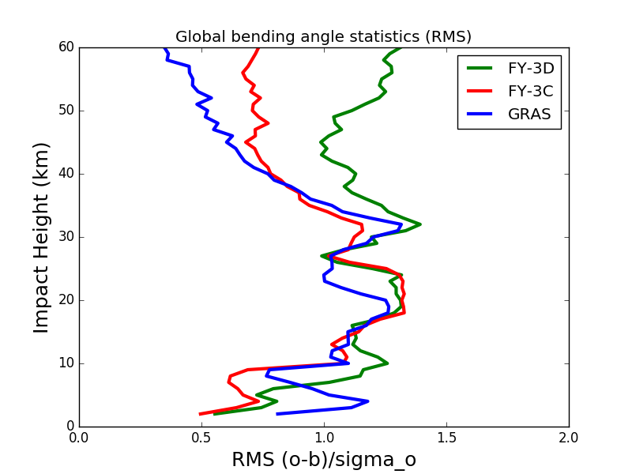
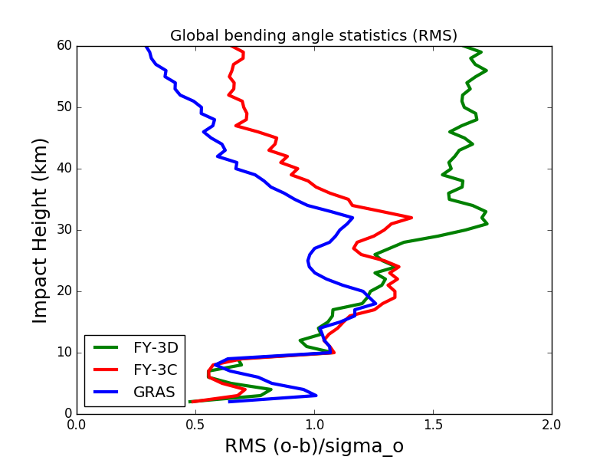
FY-3D global RMS bending angle departure statistics (May 2-5, 2018)
SET
RISING

Slide 6
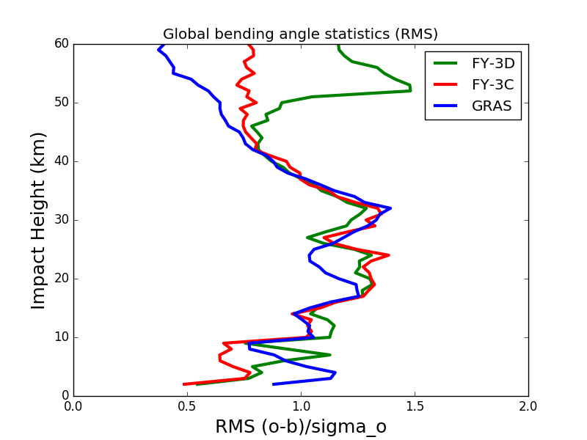
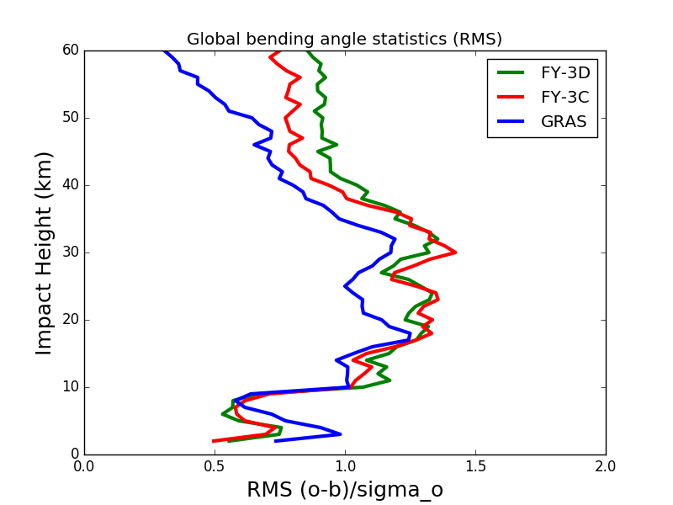
FY-3D global RMS bending angle departure statistics (July 2-5, 2018)
SET
RISING

Slide 7
Metop-C testing
Assimilation experiments delayed
Now at mid-December because of a “restart error” when I tried to extend an experiment.
  Picked up the wrong bias correction files/initial state
Nevertheless, early results looking encouraging.
  Control: Current operational data
  MetopC: Control + Metop-C
  NoRO: Control – GPS-RO.

Slide 8
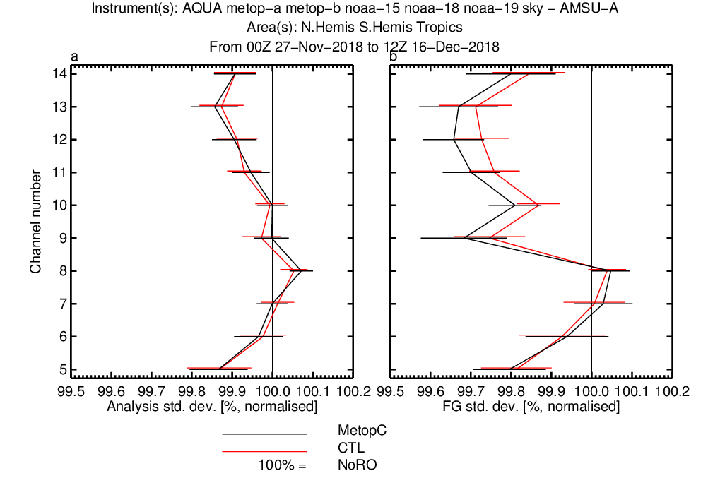
Short-range forecast fit to observations

Slide 9
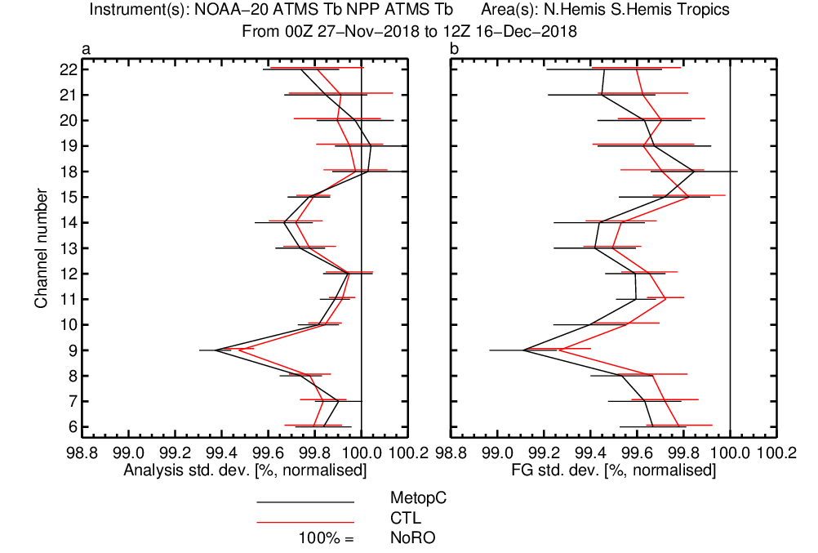
Short-range forecast fit to observations

Slide 10
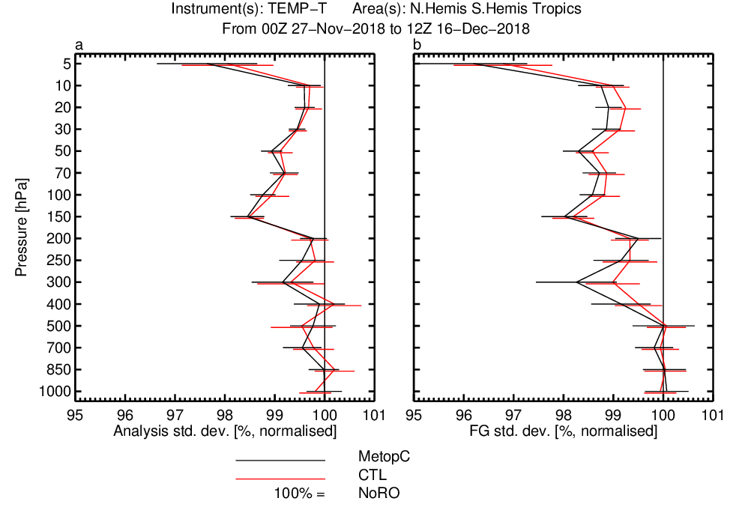
Short-range forecast fit to observations

Slide 11
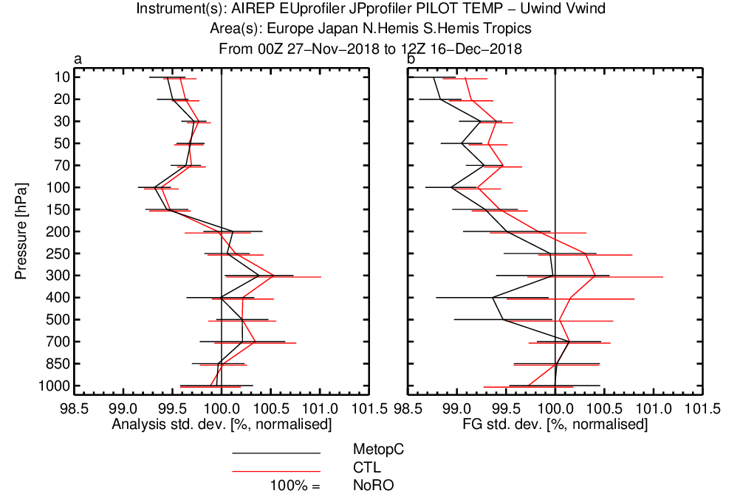
Short-range forecast fit to observations

Slide 12
Impact of bending angles above 50 km
Current blacklisted, but used in the Met Office to constrain biases.
I was sceptical. Mean bending angle at 60 km is 5 mu-rad, assumed error is 3 mu-rad.
Tested in 45R1. March 1 – June 30, 2018.
Surprisingly large impact on geopotential height RMS scores.

Slide 13
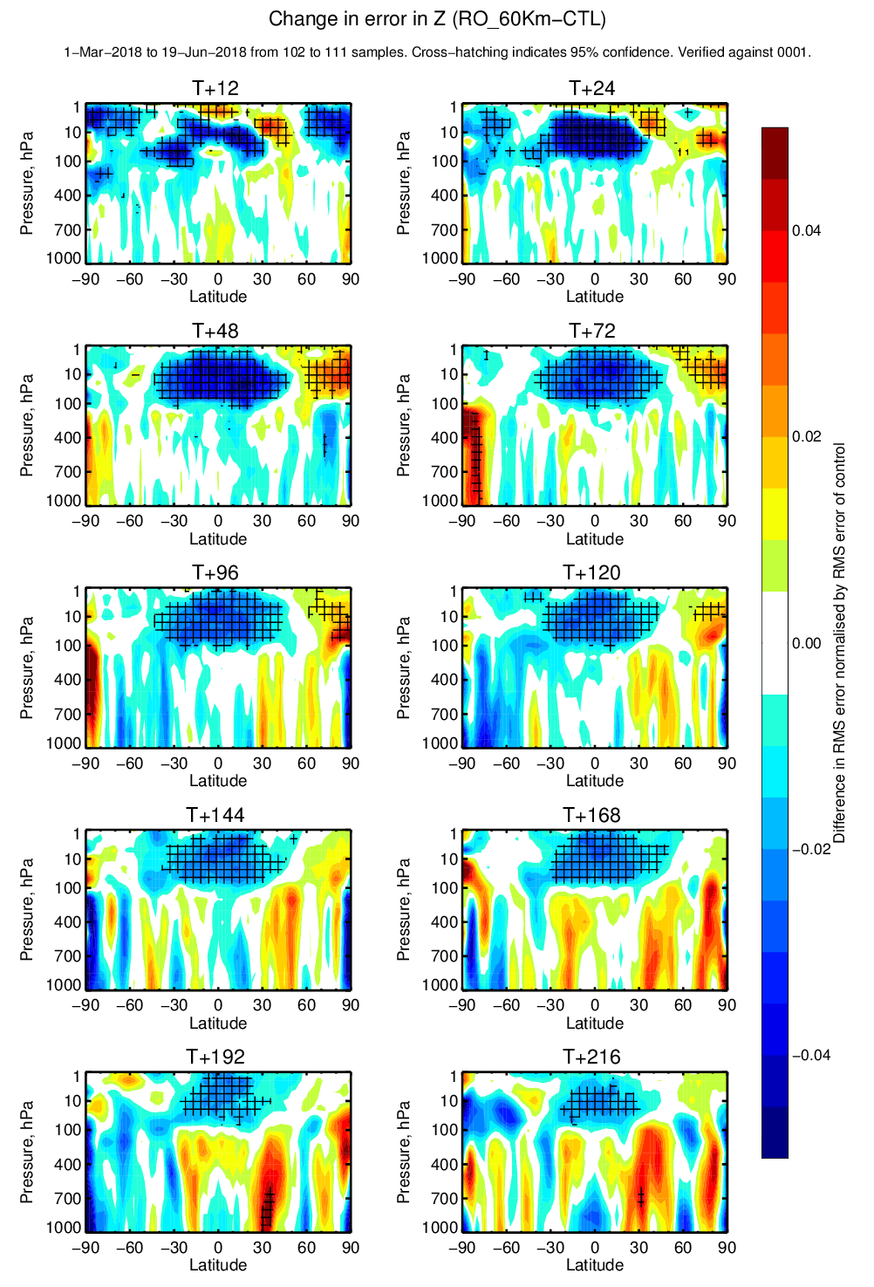
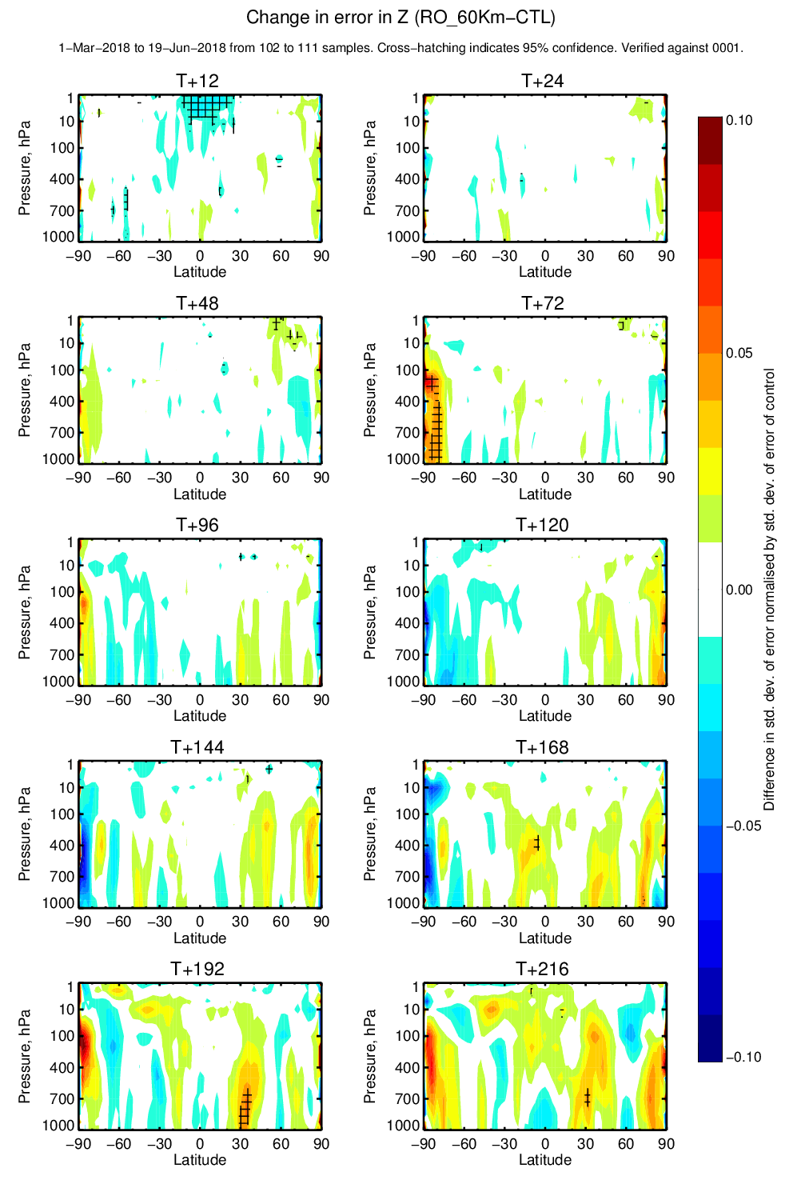
DRMS
DSTD
Main impact on bias of geopotential

Slide 14
Reanalysis
CDOP-2 backlog. Not continued in CDOP-3.
Aim: run the reanalysis system for the period 2007-2015 using just the anchor measurements and just GPS-RO (AMSU-14).
Make the reanalysis fields available.
Status: two 2007-2015 T159 experiments completed Q4 2018.
  3198: ROM SAF1, (All anchor)
  3199: ROM SAF2 (GPS-RO + AMSU-14)
  We also ran low-res T159 control
Conducting analysis/documentation prior to making them available on the web.

Slide 15
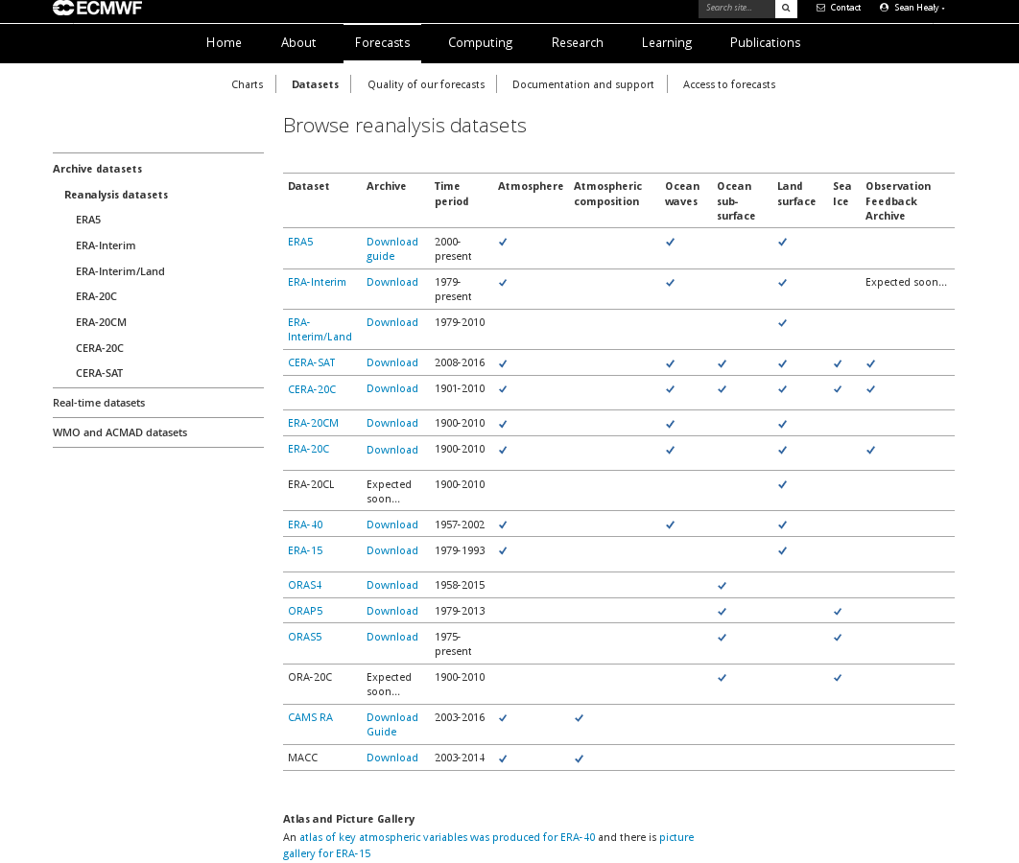
https://www.ecmwf.int/en/forecasts/datasets/archive-datasets/browse-reanalysis-datasets
Two ROM SAF reanalyses will be added here.
Gridded fields on model/pressure levels.
Monthly means etc.

Slide 16
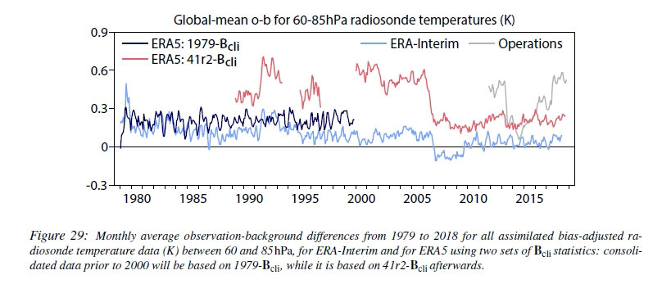
Background (ERA Report 27)

Slide 17
Some initial results

Slide 18
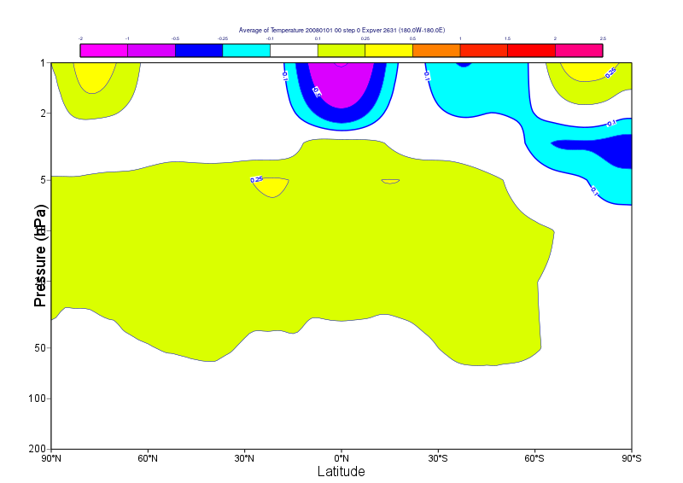
Low res CTL minus ERA5 (2008-2015)
Low res warmer
OK. ECMWF model cold bias gets worse as horizontal resolution increases.

Slide 19
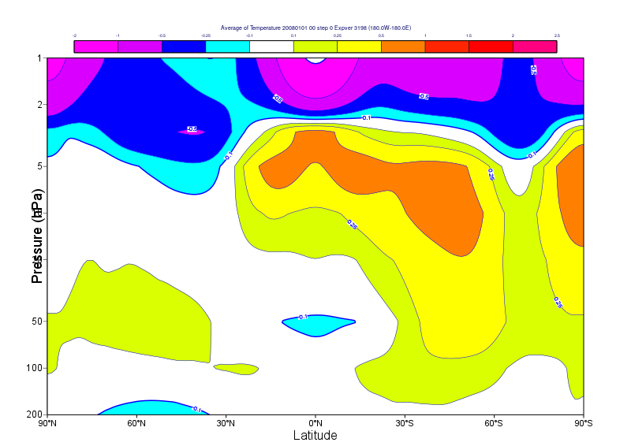
RO+CONV vs ERA5

Slide 20
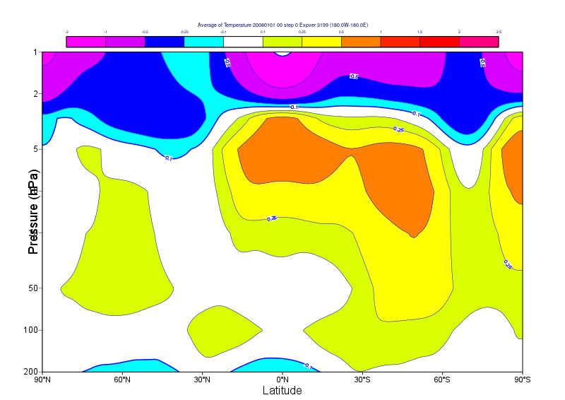
RO vs ERA5

Slide 21
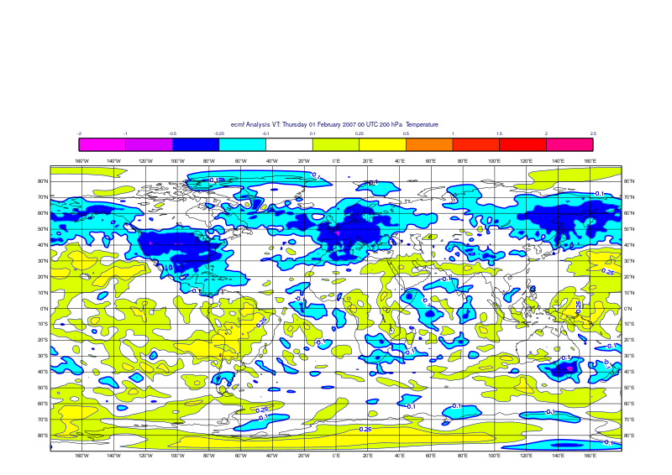
200 hPa temperature bias (RO+CONV – ERA5)
Related to incomplete bias correction of aircraft T in ERA5

Slide 22
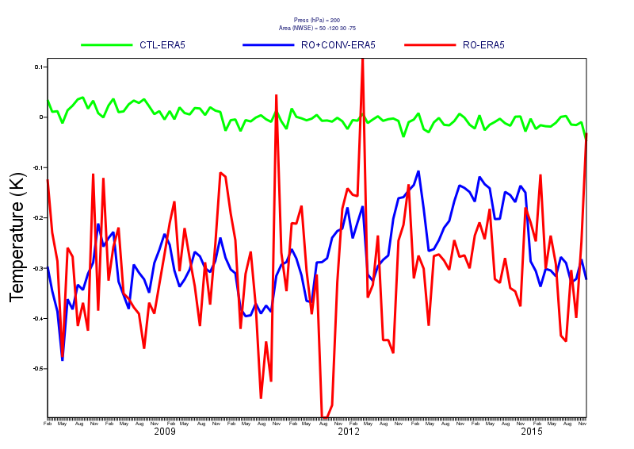
Timeseries for USA: 200 hPa temperature bias w.r.t ERA5

Slide 23
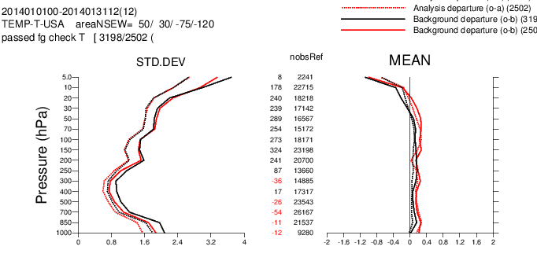
Fit to radiosondes: USA 20140101 BLACK=(RO+CONV)

Slide 24
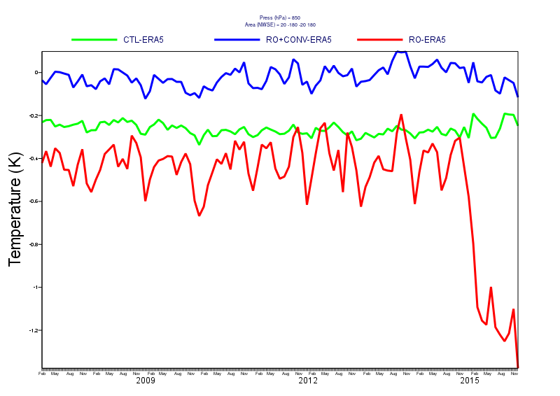
A problem, discontinuity in 2015 in the troposphere. (850).
Investigating

Slide 25
1D-Var VaryChap iono approach

Slide 26
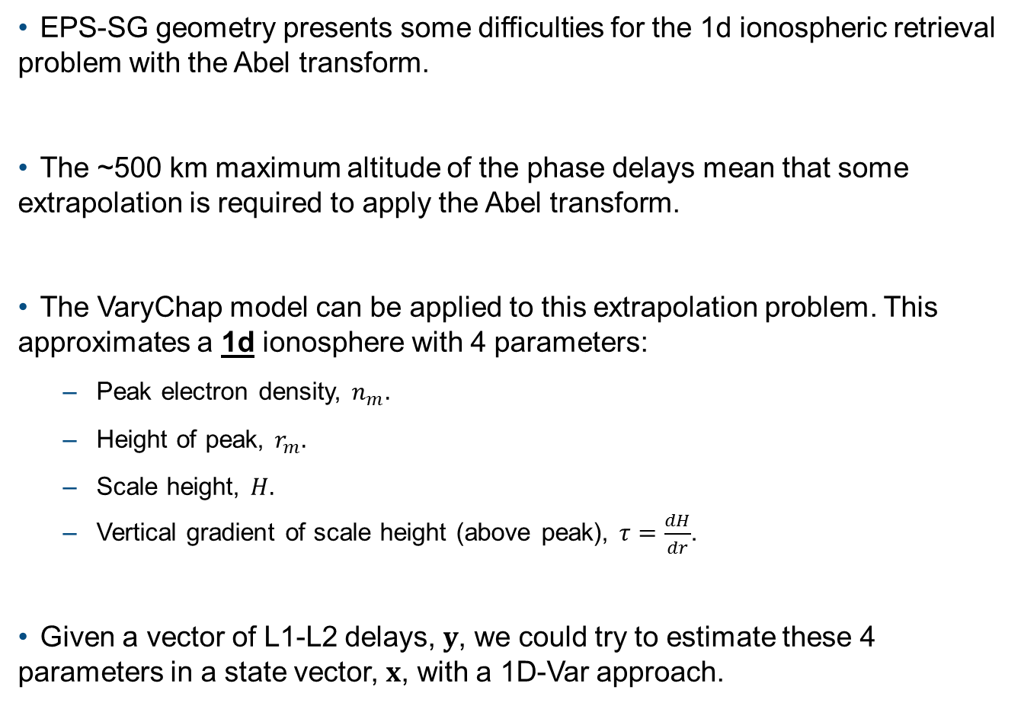
Variational approach to the ionospheric retrieval problem
EPS-SG geometry presents some difficulties for the 1d ionospheric retrieval problem with the Abel transform.
The ~500 km maximum altitude of the phase delays mean that some extrapolation is required to apply the Abel transform.
The VaryChap model can be applied to this extrapolation problem. This approximates a 1d ionosphere with 4 parameters:
  Peak electron density, $n_{m}.$
  Height of peak, $r_{m}.$
  Scale height, $H.$
  Vertical gradient of scale height (above peak), $τ=\frac{dH}{dr}$.
Given a vector of L1-L2 delays, $y$, we could try to estimate these 4 parameters in a state vector, $x$, with a 1D-Var approach.

Slide 27

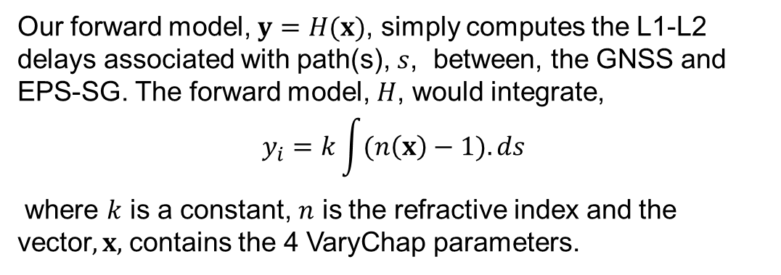
Geometry
EPS-SG
GNSS
s
Our forward model, $y=H(x)$, simply computes the L1-L2 delays associated with path(s), $s$, between, the GNSS and EPS-SG. The forward model, $H$, would integrate,
$$y_{i}=k\int{(n\left(x\right)−1).ds}$$
where $k$ is a constant, $n$ is the refractive index and the vector$,x,$ contains the 4 VaryChap parameters.

Slide 28
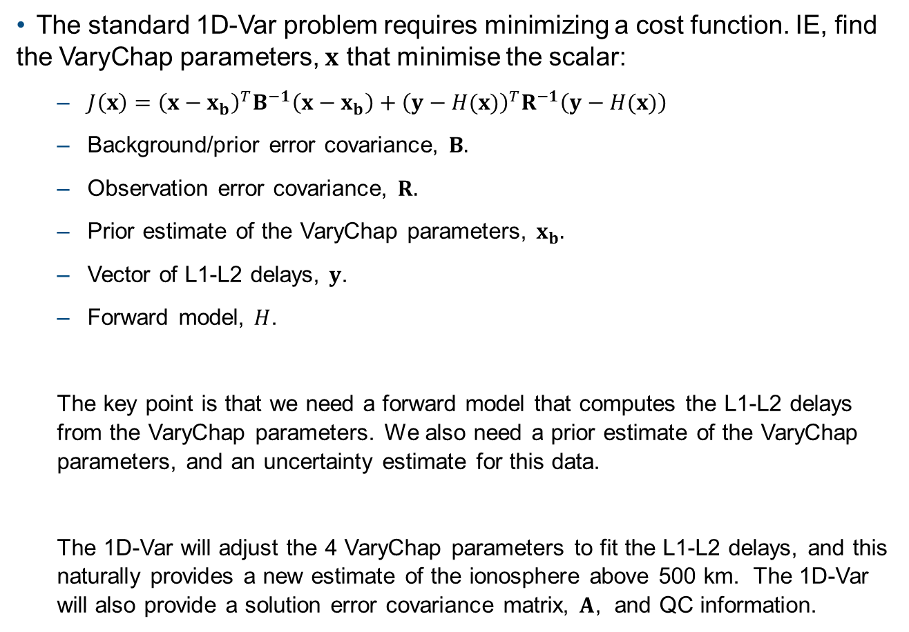
The 1D-Var problem
The standard 1D-Var problem requires minimizing a cost function. IE, find the VaryChap parameters, $x$ that minimise the scalar:
  $J\left(x\right)={\left(x−x_{b}\right)}^{T}B^{−1}\left(x−x_{b}\right)+{\left(y−H(x)\right)}^{T}R^{−1}\left(y−H(x)\right)$
  Background/prior error covariance, $B.$
  Observation error covariance, $R.$
  Prior estimate of the VaryChap parameters, $x_{b}.$
  Vector of L1-L2 delays, $y$.
  Forward model, $H$.
  The key point is that we need a forward model that computes the L1-L2 delays from the VaryChap parameters. We also need a prior estimate of the VaryChap parameters, and an uncertainty estimate for this data.
  The 1D-Var will adjust the 4 VaryChap parameters to fit the L1-L2 delays, and this naturally provides a new estimate of the ionosphere above 500 km. The 1D-Var will also provide a solution error covariance matrix, $A$, and QC information.

Slide 29
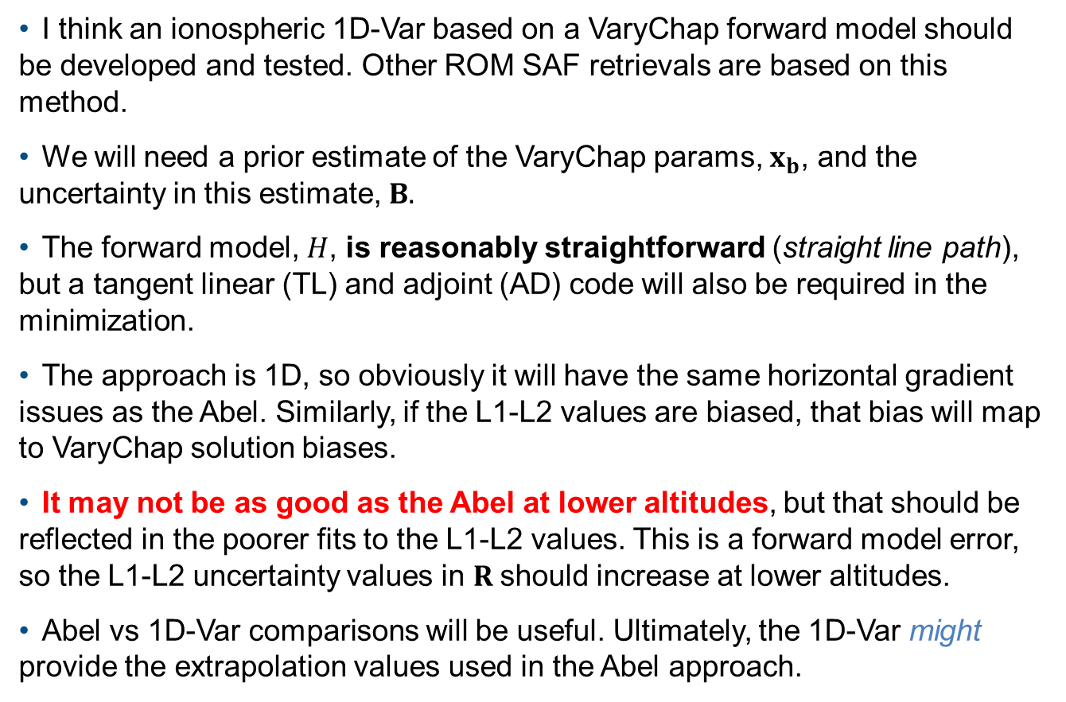
Some thoughts
I think an ionospheric 1D-Var based on a VaryChap forward model should be developed and tested. Other ROM SAF retrievals are based on this method.
We will need a prior estimate of the VaryChap params, $x_{b}$, and the uncertainty in this estimate, $B.$
The forward model, $H$, is reasonably straightforward (straight line path), but a tangent linear (TL) and adjoint (AD) code will also be required in the minimization.
The approach is 1D, so obviously it will have the same horizontal gradient issues as the Abel. Similarly, if the L1-L2 values are biased, that bias will map to VaryChap solution biases.
It may not be as good as the Abel at lower altitudes, but that should be reflected in the poorer fits to the L1-L2 values. This is a forward model error, so the L1-L2 uncertainty values in $R$should increase at lower altitudes.
Abel vs 1D-Var comparisons will be useful. Ultimately, the 1D-Var might provide the extrapolation values used in the Abel approach.

Slide 30
Forward model approach

Slide 31
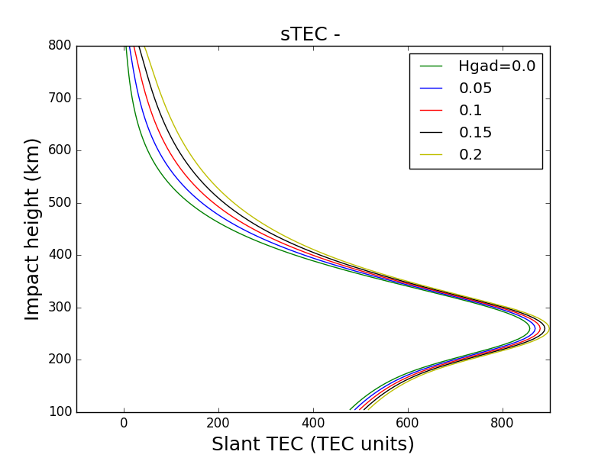
STEC example (Nm=3*e12, 300 km peak, H=50 km)
I might have to check units

Slide 32
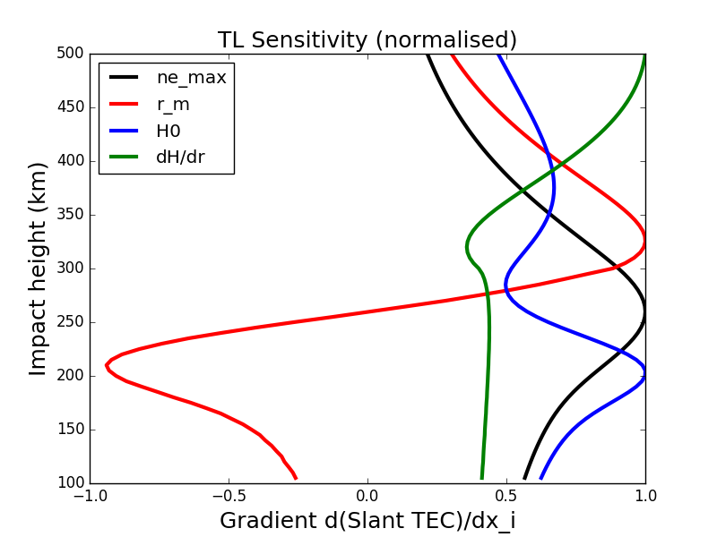
Tangent linear sensitivity d(slant_Tec)/dx_i

Slide 33
Summary
I can give more detail in an RSR if required, but this is my current thinking while the issues are still fresh after the PT meeting.
The 1D-Var will not solve all problems, but the approach is very clear, and it comes down to simulating the L1-L2 values, given the VaryChap parameters.
The extrapolation > 500 km is handled quite naturally in this framework. It will provide a VTEC estimate.
The 1D-Var performance at low altitudes will have to be tested.
The 1D-Var provides useful QC information, uncertainty estimates etc. See the Clive Rodgers book,
Inverse Methods for Atmospheric Sounding: Theory and Practice

